Slide 1

E6893 Big Data Analytics:
Genome Splicing
Team Members (with UNI):
Yu, Chenghao (cy2475)
Zeng, Yuwei (yz3302)
Zhou, Zhibo (zz2520)

Slide 2
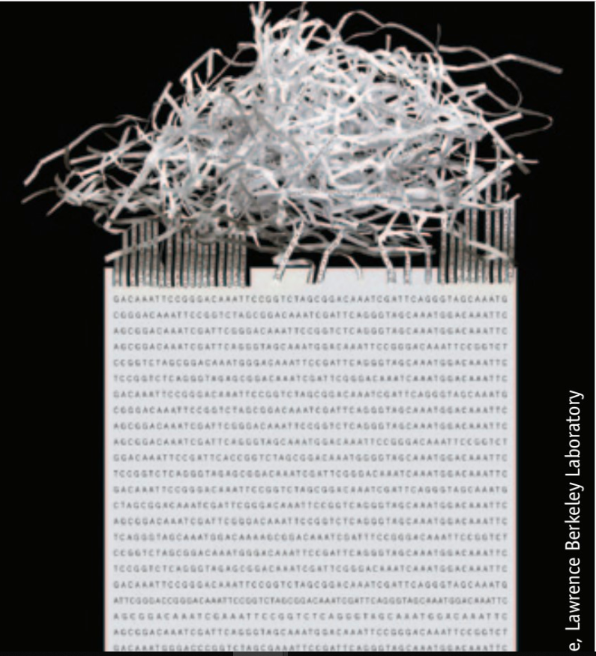
Motivation
01
1.1 PROJECT OBJECTIVE
Back to 1990, Human Genome Project was launched and cost 15 years to complete sequence for chromosomes. This was a long and arduous fight.
Fortunately, we are empowered with the Spark and Hadoop ecosystem.
So our mission is to realign sequence using distributing system and to check how fast I may achieve.
.

Slide 3
Dataset
01
1.2 DATA SOURCE: De Novo Assembly Dataset By SuperNova 2.1.0
Part I
Part II
Human: NA12878 Germline, Caucasian ancestry, female
Cell line from female of Caucasian ancestry
Human: HG00512, Chinese ancestry, female individual
DNA from male of Chinese ancestry
Web URL Of Data Source
https://support.10xgenomics.com/de-novo-assembly/datasets/2.1.0/wfu

Slide 4
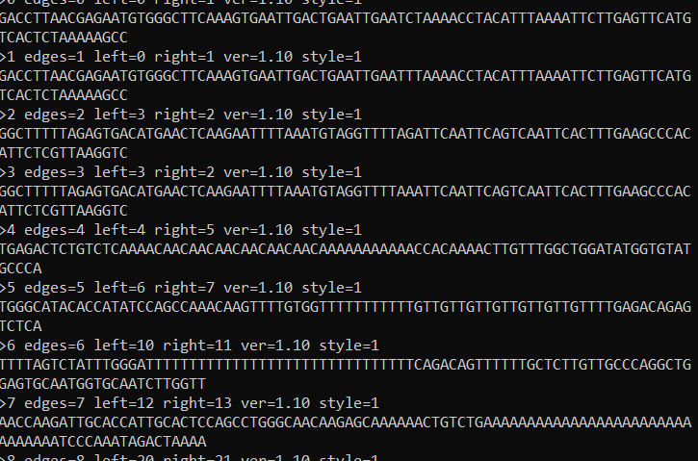
Dataset
01
1.3 DATA OVERVIEW
3 key numbers
150 ATCG base-pairs
More than 1200M pieces
More than 150G per Human

Slide 5

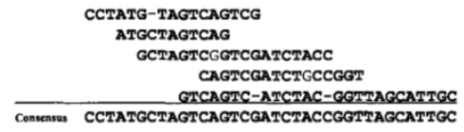
Algorithm
Overlap
2.1 Genome Assembly Method
Vertices: Reads
Edges: Overlaps
02
OLC Algorithm
R1
R2
R3
R4
This algorithm has 3 steps.
Note:
We will call a genome fragment a read.
Every read is set as a distinct value.
Layout
（1）Overlap：Compare reads pairwise, find the overlap parts and set them as keys.
（2）Layout：We could generate contigs according to key-value information
（3）Consensus: Find the heaviest sequence(the more overlap, the heavier the sequence is), which is our Assembly result
Consensus

Slide 6

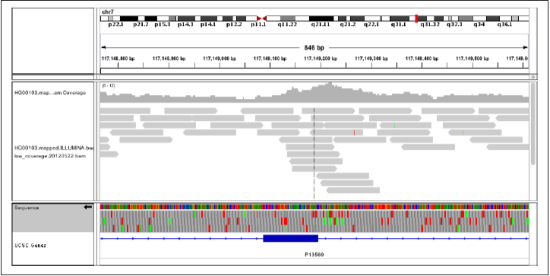
Tools
02
2.2 Software Usage
Spark Adam
Cloudera and Broad Institute launched the 4th edition of Genome Analysis Toolkit(GATK),
which runs on Apache Spark. It could be used to implement the pipeline of DNA Sequencing, such as:
ReadWalker(Global Enumerating Tool)
Count Reads
Mark Duplicates
G
A
T
K
ADAM provides a natively distributed implementation of the GATK best practices using Hadoop and Spark, which comprises set of:
Genomics-specific Avro schemas
Spark-based APIs,
Command-line tools
So, Adam is designed and suitable for large-scale genomics analysis.
A
D
A
M

Slide 7
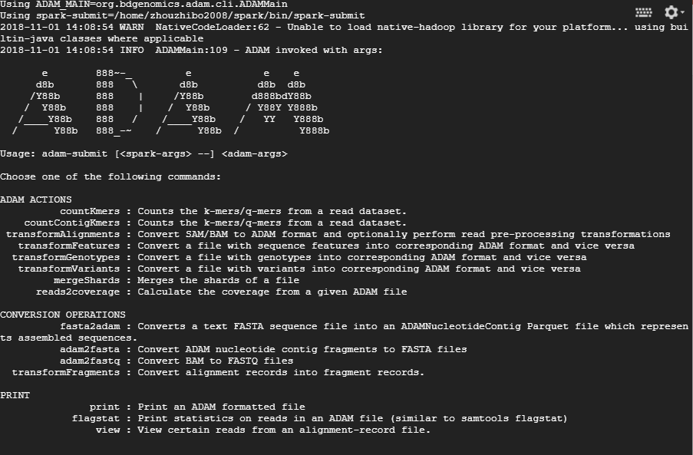
Expected Contributions and Timeline
03
3.1 Current result/state
NOW DEVELOPMENT
Transform fasta data into column-base data adam

Slide 8
Expected Contributions and Timeline
03
4.1 Project Roadmap
Future’s Work
Four
Week
Three WEEK
TWO WEEK
Now
30/11/2018
21/11/2018
Finish the writing of project document
14/11/2018
Run the pipeline on the whole dataset
10/31/2018
Try to Implement the OLC algorithm on a small sample(easy to debug) and build the pipeline
Complete the software configuration preliminarily

Slide 9
Youtube link: public
https://youtu.be/0DZxe8PjEqA

